Slide 1
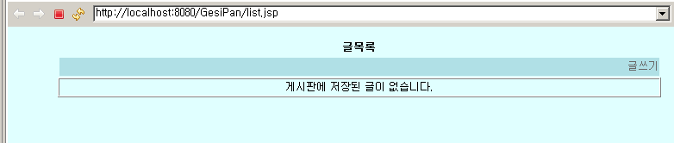
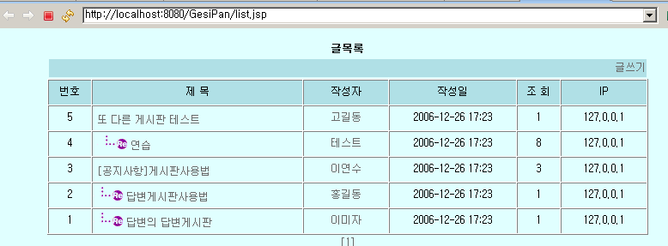
게시판목록보기
pageNum
List articleList
getArticles()
BoardDAO
DBConnectionMgr
Board

Slide 2
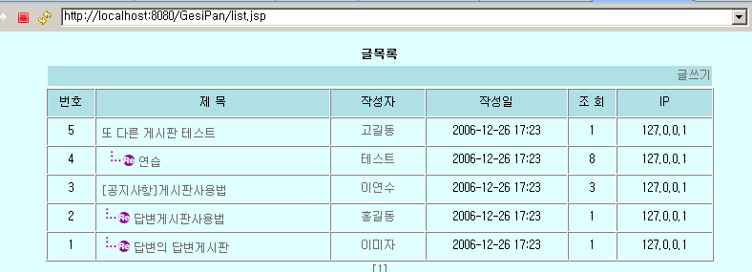
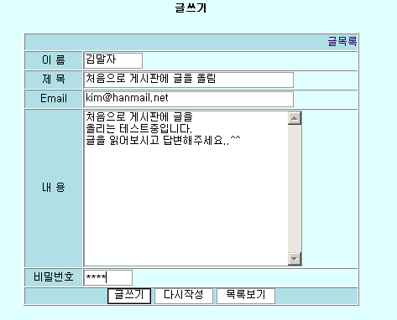
게시판에 글쓰기
num,ref,re_step,
Re_level이 없음
List.jsp
writeForm.jsp
writePro.jsp
insertArticle
(BoardDTO article)
BoardDAO
DBConnectionMgr
Board

Slide 3
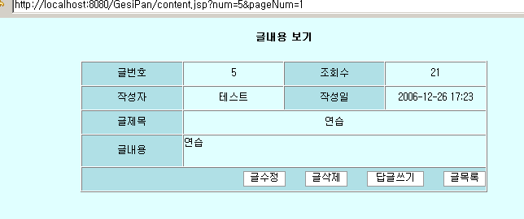
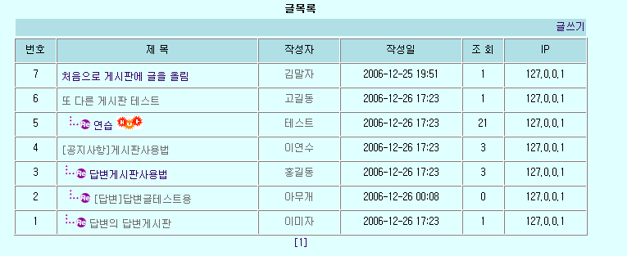
답변글쓰기
num,ref,re_step,
Re_level(답변글)
writeForm.jsp
content.jsp
writePro.jsp
insertArticle
(BoardDTO article)
list.jsp
BoardDAO
DBConnectionMgr
Board

